Slide 1
Prepare for 2024
Presented by ITR Economics Economist and Speaker
Jeremy Bess

Slide 2
2022 Forecast Results
 | Duration | Accuracy
US GDP | 18 | 98.9%
US Ind. Production | 18 | 98.9%
Europe Ind. Production | 23 | 99.6%
Canada Ind. Production | 24 | 99.5%
China Ind. Production | 16 | 98.5%
Retail Sales | 13 | 98.0%
Housing - Single Family | 17 | 84.8%
Employment-Private Sector | 13 | 98.7%
ITR Economics provides the best economic intelligence to reduce
risk and drive practical and profitable business decisions.

Slide 3
Global Forces

Slide 4
Percent of World GDP by Country
Source: IMF, *ROW: 70% are IMF Estimated Figures
*Total World GDP:
$100.2 Trillion US $

Slide 5
Strong Cyclical Relationship
Sources: FRB, CPB Netherlands Bureau For Economic Policy Analysis
US Industrial Production Index to World Industrial Production Index
12/12 Rates-of-Change
Late 2024 low

Slide 6
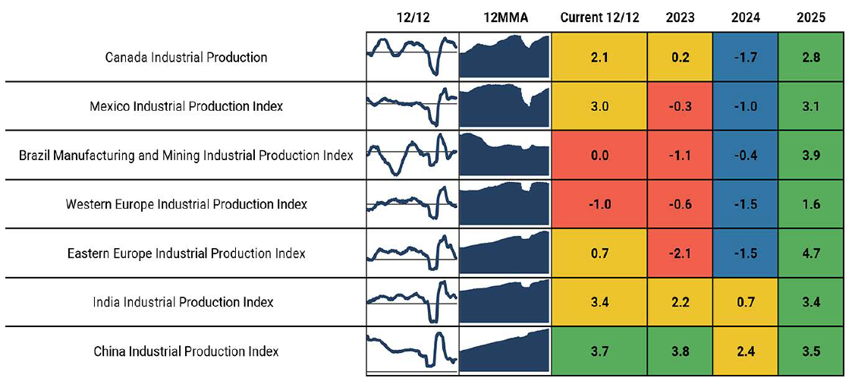
The Global Economy At-a-Glance
Source: ITR Economics Trends ReportTM
Iran

Slide 7
The Decelerating Rise is Becoming More Apparent
Sources: China National Bureau of Statistics
China Industrial Production Index (Logarithmic Scale)
Annual Data Trends: 2012 = 100

Slide 8
Lack of Labor in China
Sources: BLS, China National Statistics Bureau
US Private Sector Employment to China Employment
Annual Data Trends: Millions of People

Slide 9
Strength for the Americas
Source: World Bank
Total Population Age 15-64 With Projections – US, Mexico, Canada, Brazil
Millions of Persons

Slide 10
Risks and Opportunities
China is becoming more of a problem going forward with mounting risks
US economy is the best long-term plan you could have
Lessen your reliance on China in the coming years
Russia is a hollowed-out version of its former self
Supply chain pressures are easing

Slide 11
The US Economy

Slide 12
Expect an Essentially Flat 2024
Source: BEA
US Real Gross Domestic Product
Quarterly Data Trends: Trillions of Chained 2012 Dollars
2023 0.9% 2024 -0.3% 2025 2.5%

Slide 13
Inverse Yield Curve in Place: Business Cycle Decline Ahead
Source:
US Treasury Dept.
US Government Long-Term Bond Yields to US 3-Month Treasury Bond Yield
Raw Data: Percent

Slide 14
Contraction Expected by 4Q23
Source: FRB
US Industrial Production Index
2017 = 100
2023 0.2% 2024 -3.6% 2025 2.0%
Dec 2024 low

Slide 15
COVID Surge is Over; Real Test is Ahead
Source: BEA
US Domestic Nonfinancial Industries Corporate Profits
(with capital consumption adjustments)
Billions of Dollars

Slide 16
Capital Goods Purchases Continue to Decelerate
Source: US Census Bureau
US Nondefense Capital Goods New Orders (excluding aircraft)
Billions of Dollars

Slide 17
Higher Prices Incentivizing Energy Production
Source: FRB
US Oil and Gas Extraction Production Index
2017 = 100

Slide 18
Downstream Oil & Gas Remains Below Pre-Pandemic Levels
Source: FRB
US Petroleum Refineries Production Index
2017 = 100

Slide 19
Low Commodity Prices Impacting Production
Source: FRB
US Mining Production Index (excluding oil and gas)
2017 = 100

Slide 20
Volatile Times for Vehicle Production
Source: WardsAuto
North America Light Vehicle Production
Millions of Units

Slide 21
Food Production Hindered by Low Profits and Utilization
Source: FRB
US Food Production Index
2017 = 100

Slide 22
Construction Machinery Demand Will Continue to Slow
Source: US Census Bureau
US Construction Machinery New Orders
Billions of Dollars

Slide 23
The US Macroeconomic Summary
Ignore the political noise
Watch the inverse yield curve
Invest in your business
Good opportunity for organic growth in 2025
Businesses are less profitable, and cash is below year ago level
Slower growth in consumer spending

Slide 24
Labor

Slide 25
Employees Market
Source: BLS
US Number of Unemployed Persons per Job Opening
Raw Data, Number of Persons

Slide 26
Culture: Do Well, Do Good, Be Aware
Source: BLS
US Civilian Labor Force Participation Rate For Ages 16-24, 25-34, 35-44, 45-54, 55-64,
and Over 64
Annual Data Trends, Percent

Slide 27
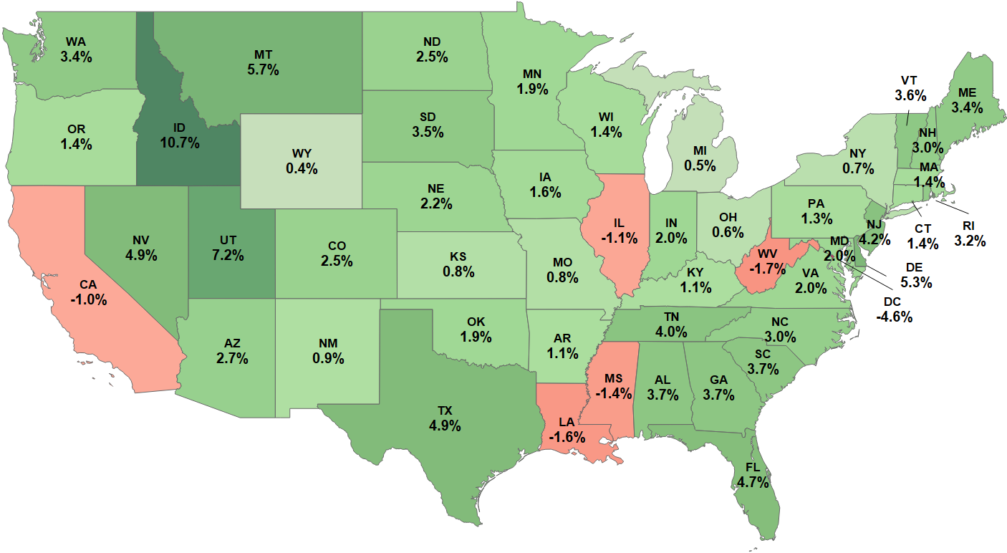
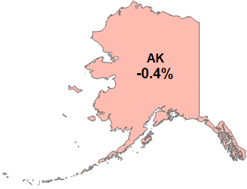
Be Geographically Specific: State Population Growth 2018 to 2022
Source: US Census Bureau
Population Growth 2018 – 2022, Percent Change

Slide 28
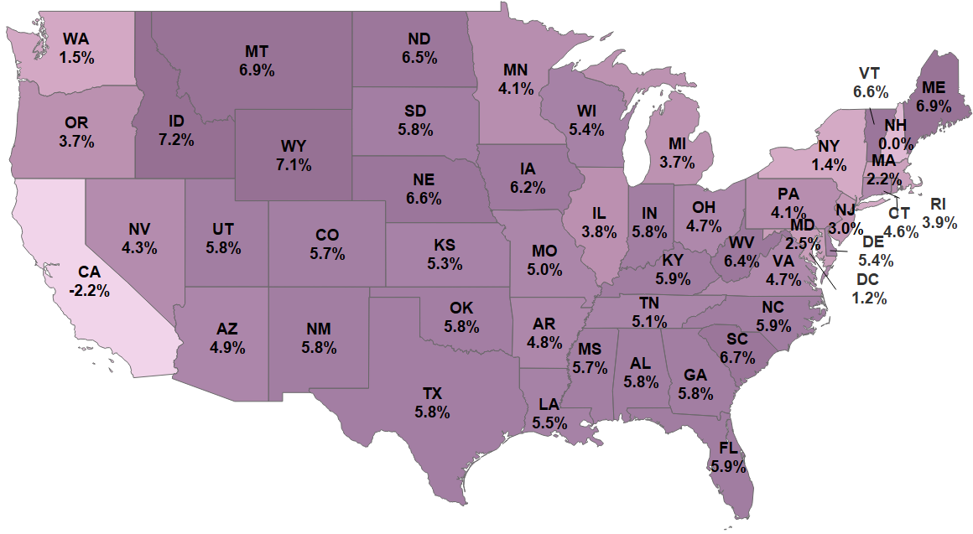
US Wage Inflation by State
Source: BLS
12/12 Rates-of-Change

Slide 29
Labor Summary
Disinflation on wages late in 2023 and in 2024
Baby Boomers are leaving
Preparing the next generation
Tight labor market for years
It is all about the culture

Slide 30
Inflation Trends

Slide 31
Deflationary Trends
Sources: WSJ, LME, BLS
Commodity Prices for Copper, Nickel, and Aluminum to
US Producer Price Indexes for Copper, and Stainless Steel
3/12 Rates-of-Change

Slide 32
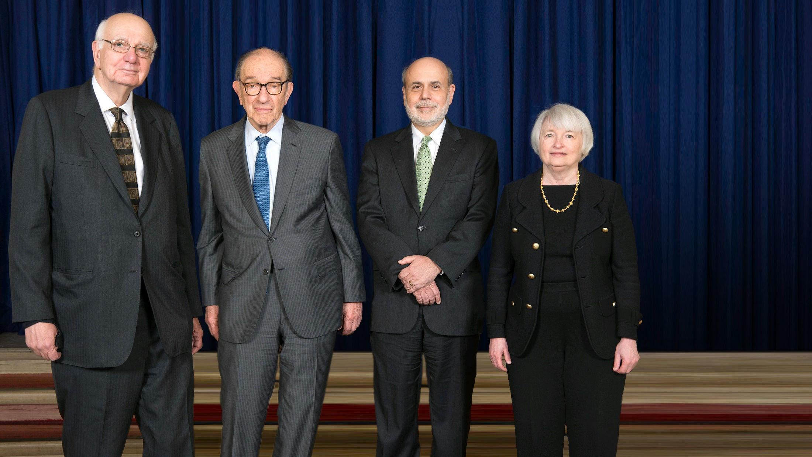
Future US Bond Yields
Source: FRB

Slide 33
FOMC Member Interest Rate Projections
Source: FRB
Fed Open Market Committee | September 2023
Take advantage of lower interest rates
Make acquisitions
Invest in your products – innovate
Invest in your processes
Longer Run

Slide 34
Construction Markets

Slide 35
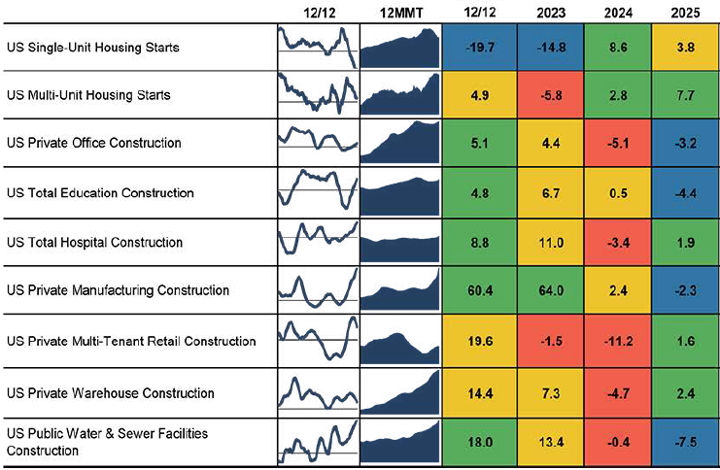
The Construction US Economy At-a-Glance
Source: ITR Economics Trends ReportTM

Slide 36
Recovery is Underway
Source: US Census Bureau
US Single Unit Housing Starts
Millions of Units

Slide 37
Permits Lead Housing Starts
Source: US Census Bureau
US Housing Starts to US Housing Unit Building Permits
Rates-of-Change

Slide 38
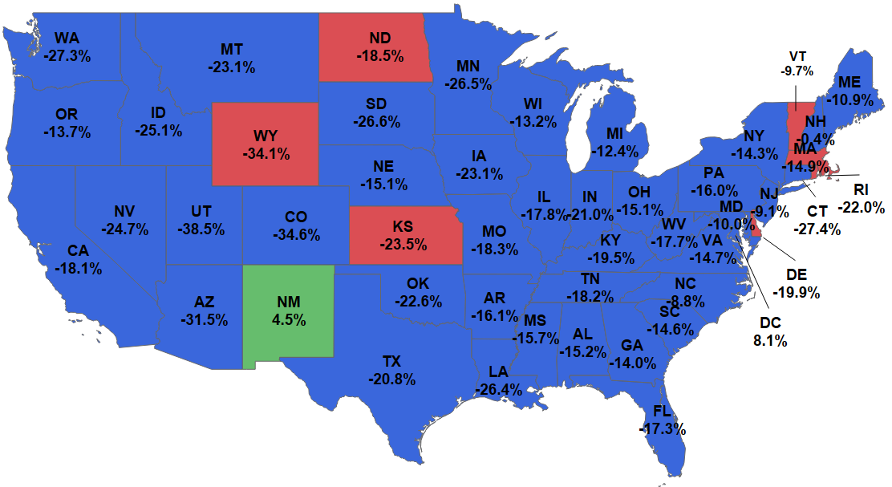
US Single-Family Housing Unit Permits by State
Source: US Census Bureau
12/12 Rates-of-Change

Slide 39
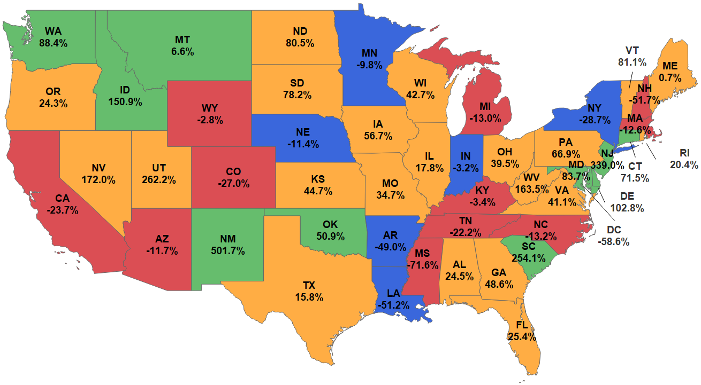
US Residential Remodeling Construction by State
Source: ConstructConnect
12/12 Rates-of-Change
Put in Place

Slide 40
Downside Cyclical Pressure in 2023
Source: US Census Bureau
US Multi-Unit Housing Starts to US Multi-Unit Housing Permits
12/12 Rates-of-Change

Slide 41
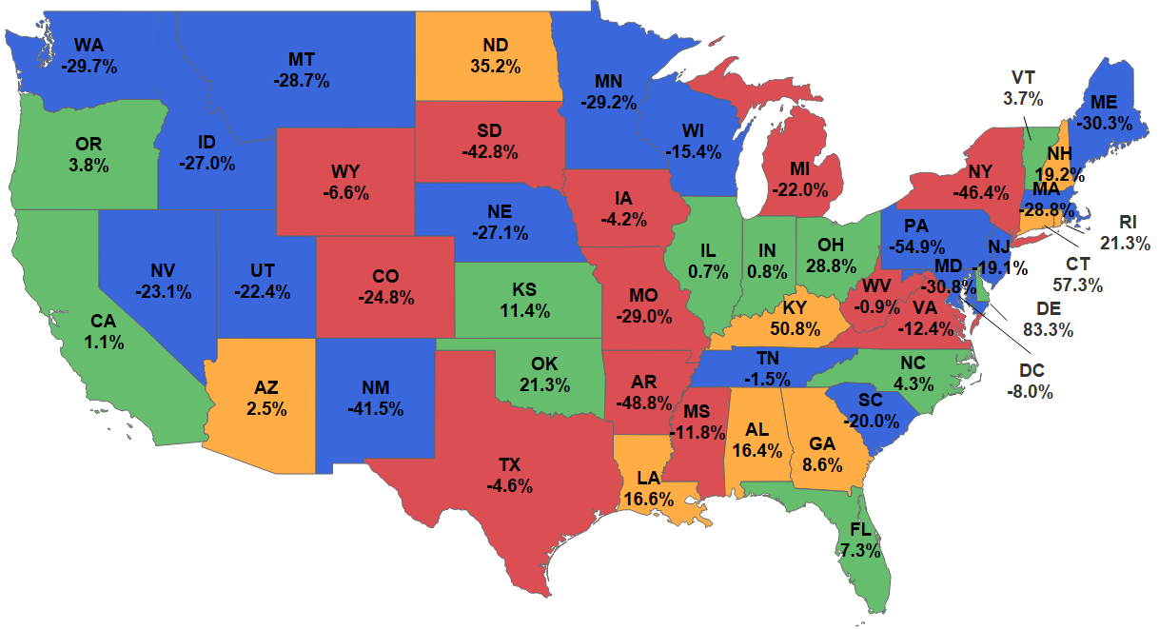
US Multi-Family Housing Permits by State
Source: US Census Bureau
12/12 Rates-of-Change

Slide 42
Housing Leads – Nonresidential Lags
Source: US Census Bureau
US Private Nonresidential Construction to US Single-Unit Housing Starts
12/12 Rates-of-Change

Slide 43
US Commercial Construction by State
Source: ConstructConnect
12/12 Rates-of-Change

